Slide 1
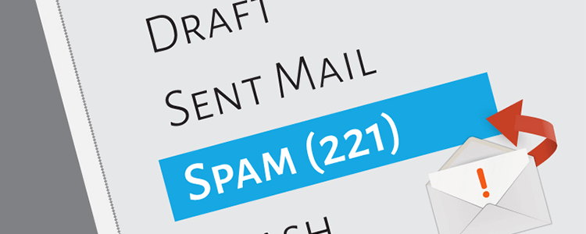
BI Mid Project:
Spam Email Prediction & Visualizations with Power BI
Viona Zatil Aqmar Kaleb (001202207001)
MSIT

Slide 2

Background
In today's digital world, email communication has become really important.
However, it is also haunted by the ever-persistent issue of email spam, causing annoyance and security concerns. This project seeks to develop a reliable email spam prediction system to identify spam emails, ensuring a safer and more productive email experience for users.

Slide 3
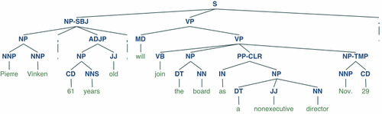
Introduction
In this project, text processing is carried out using NLTK, which involves tokenization, removing non-alphabetic characters, and eliminating common English stopwords.

Slide 4
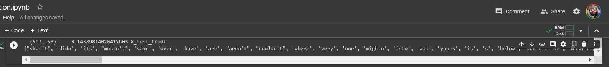
Additionally, the Term Frequency-Inverse Document Frequency (TF-IDF) vectorization technique is used to transform the preprocessed text into numerical features.
For email classification, a Multinomial Naive Bayes classifier is selected and trained using the TF-IDF-transformed features on the training data.

Slide 5
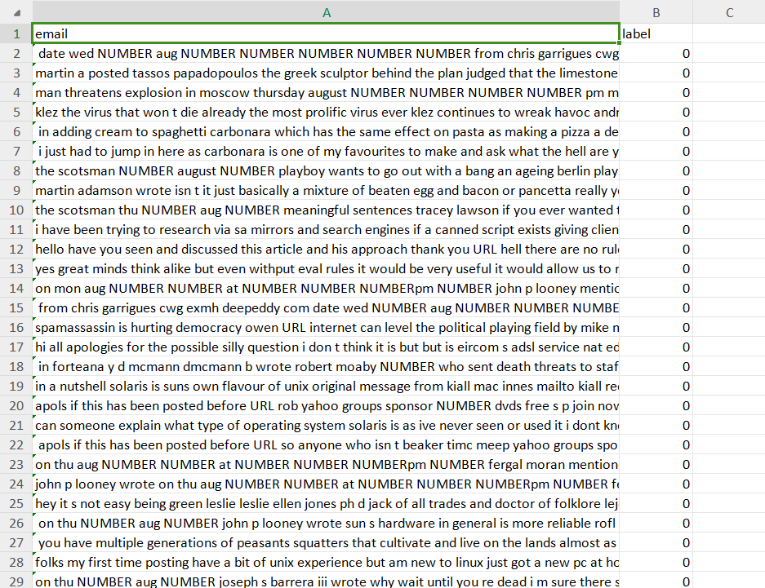
Dataset
The dataset was retrieved from https://spamassassin.apache.org/old/publiccorpus/ i.e. Apache SpamAssassin’s public datasets.
There are 2500 ham and 500 spam emails in the dataset. All the numbers and URLs were converted to strings as NUMBER and URL respectively. This is the simplified spam and ham dataset.
Data label 1 indicates spam, while 0 indicates non-spam email.

Slide 6
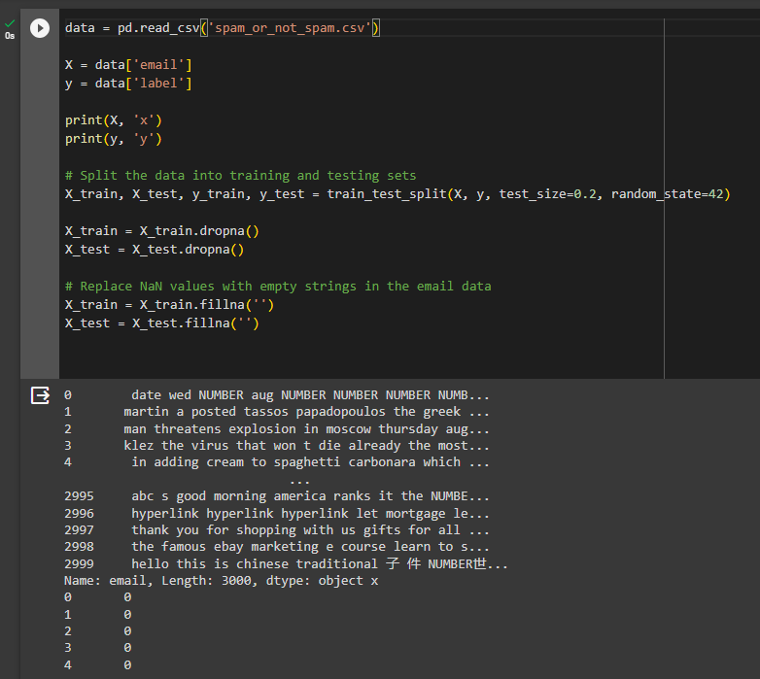
Data Source
The project starts by loading email data from a CSV file named 'spam_or_not_spam.csv'.
This dataset likely contains a collection of emails along with labels indicating whether each email is spam (1) or not spam (0).

Slide 7
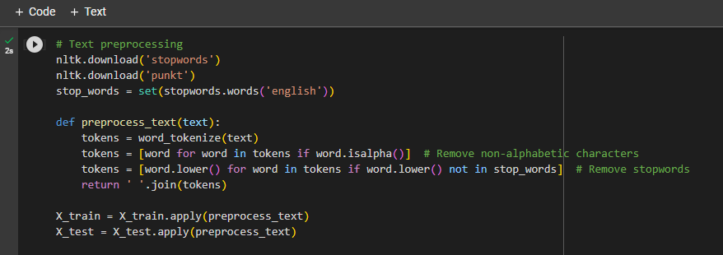
2. Text Preprocessing
The email content is preprocessed to prepare it for machine learning. This includes tokenization (splitting text into words), removal of non-alphabetic characters, and eliminating common English stopwords (e.g., "and," "the," "is").
These steps help clean and normalize the text data.

Slide 8
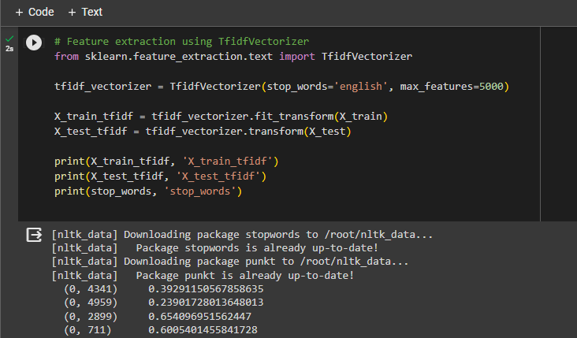
3. Feature Extraction
The code uses the TF-IDF (Term Frequency-Inverse Document Frequency) vectorization technique to convert the preprocessed text data into numerical features.
TF-IDF assigns numerical values to words based on their importance within each document and across the entire dataset. It helps in converting text data into a format suitable for machine learning.

Slide 9
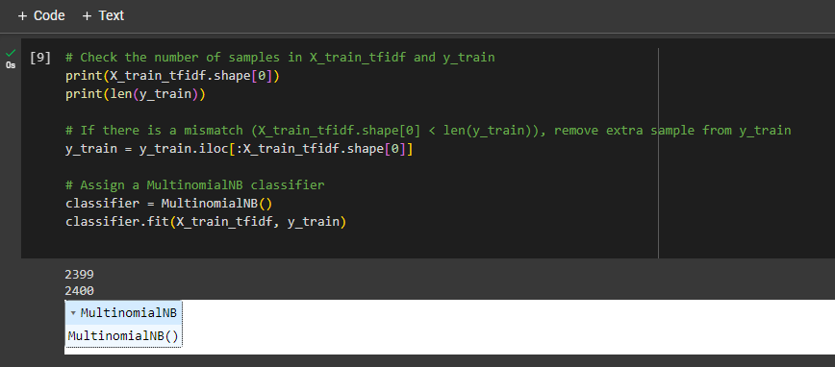
3. Classification Model
The project employs a Multinomial Naive Bayes classifier, a common choice for text classification tasks.
The classifier is trained using the transformed text data, with the aim of learning to distinguish between spam and non-spam emails.

Slide 10
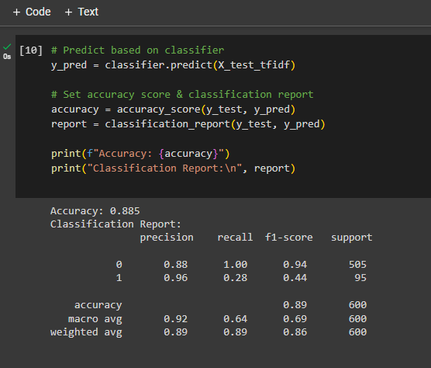
4. Prediction and Evaluation
After training, the classifier is used to make predictions on a test dataset. The accuracy of the model is computed, indicating how well it can classify emails correctly.
The accuracy of the model is 88.5% .
A more detailed evaluation is provided through a classification report as the image shows. Which includes precision, recall, and the F1-score for both classes (spam and not spam).

Slide 11
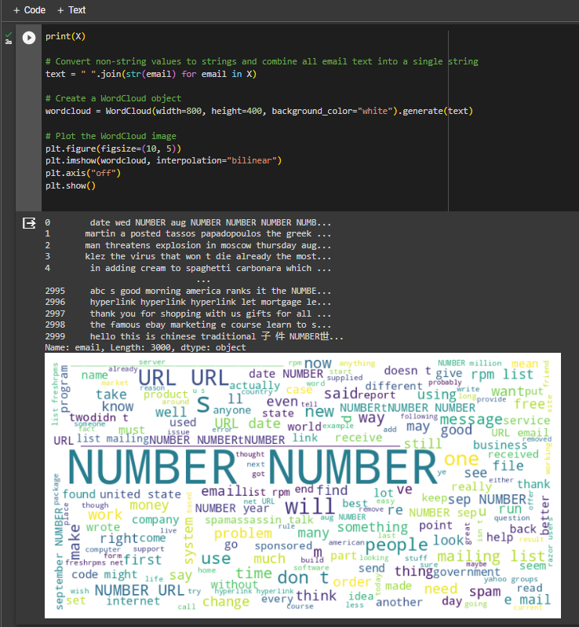
5. Visualization
The project includes visualizations to help users understand the performance of the model.
Word Cloud is generated to create a visual representation of the most common words in the entire email dataset. This can provide insights into the types of words that are prevalent in spam and non-spam emails.
‘NUMBER’ and ‘URL’ are the most frequent words appeared.

Slide 12
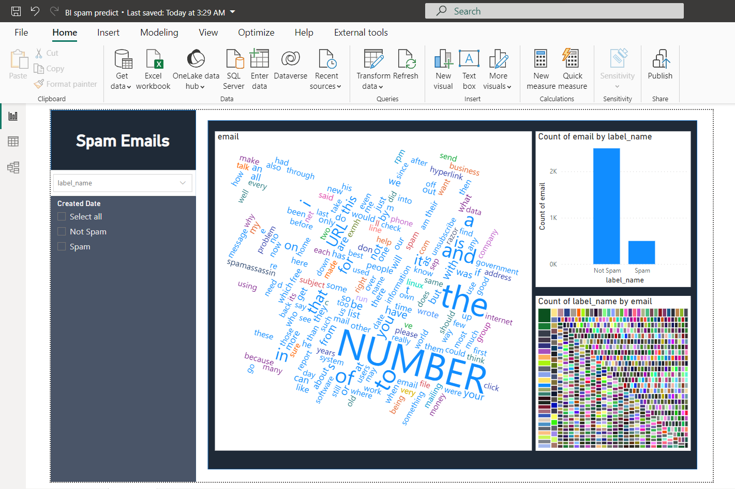
6. Power BI
Visualization
Power BI is also implemented to process and visualize the data.
Slicers, word cloud, bar chart, and treemap are used to identify which term appears frequently.
In Power BI, ‘NUMBER’ and ‘URL’ are still the most frequent words appeared.

Slide 13
Conclusion
The accuracy of the model is 88.5% . And based on the evaluation and visualization on both Python and Power BI, ‘NUMBER’ and ‘URL’ are the most frequent words appeared. And almost all of the spam emails contain those two words.

Slide 14
Files
Viona Z A Kaleb - 001202207001 https://drive.google.com/drive/u/1/folders/13UYfuKj3Pf19QdeMaahNRAEtk057A4HN
Also available on Github: https://github.com/vionakaleb/business-intelligence-mid?search=1

